Slide 1
10 classes: 1 safe, 9 distractions
Distracted Driver Detection
Can simple models on raw pixels recognise what a driver is doing, even for drivers they have never seen?
UE24CS352A Machine Learning | Mini-Project | Problem #24
Arya Devang (PES1UG24AM054) | Ananthakrishna (PES1UG24AM036)
github.com/Arya-677/ML_miniProject_sem5
Notes:
Introduce the team and the problem in one sentence: given one in-cabin image, predict the driver's activity (10 classes). We re-implemented the CS229 report by Feng & Yue and extended it with a stricter test: unseen drivers. Roadmap: problem and data, pre-processing, the five models, training and verification, results, best-model analysis, conclusions and demo.

Slide 2
One image in, one of 10 activities out
Task
Given a single in-cabin camera frame, classify the driver's activity.
Why it matters
Distracted driving contributes to serious crashes, and different activities carry different risk.
Basis
Re-implementation of the CS229 report (Feng & Yue, 2019): five classifiers on raw pixels.
c0 Safe driving
c1 Texting - right
c2 Phone - right
c3 Texting - left
c4 Phone - left
c5 Operating radio
c6 Drinking
c7 Reaching behind
c8 Hair and makeup
c9 Talk to passenger
Our question: how well do simple models work on raw pixels, and does that accuracy hold for drivers the model has never seen?
Notes:
Explain the 10 classes (c0 safe driving, c1-c9 distractions). Stress the two parts of our question: (1) compare five models, (2) test whether accuracy survives on new drivers. The second part is what we added on top of the reference paper.

Slide 3
State Farm data, and two ways to split it
22,424
10
26
640x480
labelled images
classes
drivers
RGB frames
A Random 80/20 split
B Driver-wise 80/20 split
Same protocol as the reference report
17,940 train / 4,484 val
All 26 drivers appear on both sides
Near-duplicate frames leak across: may be optimistic
Whole drivers held out for validation
17,747 train / 4,677 val
21 train drivers, 5 val drivers, 0 overlap
Measures real-world generalisation to new people
Why two? Images are video frames, so one driver's frames look almost identical. The official test set is unlabelled, so we hold out 20% of the labelled data.
Notes:
Key idea of the whole project: the dataset has 26 drivers and each contributes thousands of near-identical frames. A random split puts the same person in train and validation, so a model can memorise people. The driver-wise split fixes that: 21 drivers train, 5 drivers validate, zero overlap. We report both so the results can be compared with the reference paper (random) and also show the honest number (driver-wise).

Slide 4
Pre-processing: image to 12,288 numbers
Image
Resize
Flatten
Normalise
Classifier
640x480x3
>
64x64x3
>
12,288-vector
>
/255, minus mean
>
5 models
921,600 values
OpenCV, INTER_AREA
one row per image
train-set mean image
scores for 10 classes
75x fewer inputs
0 val. leaks
1x cached
921,600 down to 12,288 values, small enough for from-scratch NumPy training
the mean image uses training data only, so validation never influences pre-processing
all 22,424 images stored once as .npz, so repeated runs start instantly
Notes:
Walk left to right. Resizing to 64x64 is a trade-off: it makes from-scratch training feasible but loses fine detail (phone versus hand). Subtracting the training mean image centres the data, which helps gradient descent. The mean is computed on the training split only to avoid leakage.

Slide 5
Five models, five different ideas
Model | Built | How it decides | Distinctive feature
Linear SVM | NumPy | Scores = XW + b; multi-class hinge loss (margin 1) + L2 | Only margin violators give gradient; linear boundary, no probabilities
Softmax | NumPy | Same linear scores; cross-entropy + L2 | Gives class probabilities; every sample contributes to the gradient
Two-layer NN | NumPy | 12,288 > 100 ReLU > 10 softmax; 1.23M weights | Learns non-linear features; He init, learning-rate decay 0.9 per epoch
Naive Bayes | scikit-learn | One Gaussian per pixel per class, assumes pixels independent | No iterative training (26 s) but ignores pixel correlations
Decision Tree | scikit-learn | Axis-aligned threshold splits on single pixel values | Default, unpruned: reaches 100% train accuracy, ~4 min to fit
Teal = implemented from scratch (loss, gradient and SGD loop written by us). Amber = scikit-learn baselines.
Notes:
Go row by row, one sentence each. SVM and softmax share the same linear scores W x + b and differ only in the loss: hinge versus cross-entropy. The neural net adds one hidden ReLU layer of 100 units so it can learn non-linear features; parameter count is 12,288*100 + 100 + 100*10 + 10 = 1,229,910. Naive Bayes fits a Gaussian per pixel and class and assumes pixels are independent, which is clearly false for images. The decision tree uses scikit-learn defaults, so it grows until it fits every training example.

Slide 6
Trained carefully, verified numerically
1
Training recipe
2
Tuning, no peeking
3
Gradient check
Mini-batch SGD, 256 (linear) / 200 (NN)
Iterations: 2,000 for all three
Init: 0.001 randn (linear), He (NN)
Fixed seed 0: SVM/softmax are init-sensitive
Grid: learning rate x regularisation
Linear: 4 x 3 = 12 settings
NN: 3 x 3 = 9 settings
Scored on an inner split of TRAIN only
SVM: 2.1e-10
Softmax: 7.4e-11
NN (W1, b1, W2, b2): below 6e-11
Analytic vs numeric gradients
Best settings chosen | Linear SVM | Softmax | Two-layer NN
Random split (lr, reg) | 1e-3, 1e-4 | 1e-3, 1e-2 | 3e-2, 1e-4
Driver-wise (lr, reg) | 3e-4, 1e-3 | 1e-3, 1e-2 | 3e-2, 1e-3
Notes:
Three points. (1) Training: plain mini-batch SGD for 2,000 iterations, fixed seed, He initialisation for the network. (2) Tuning: grid search over learning rate and regularisation, scored on an inner split carved out of the training set, so the validation set is used once for the final number. Note the best learning rate for the SVM differs between protocols. (3) Verification: we compared our analytic gradients to numerical gradients and the maximum error is around 1e-10, so the from-scratch maths is correct.

Slide 7
Accuracy collapses on unseen drivers
-41.6
points: average drop, random to driver-wise
NN
best model under both protocols (98.0% / 51.6%)
Reference paper (random split): NN 92.2, softmax 82.3, SVM 71.4, tree 84.7, NB 55.0. Our SVM is far higher because we tuned lr/reg by grid search and fixed the initialisation (the paper found SVM init-sensitive).
Notes:
Read the chart in two steps. Teal bars (random split): ranking is NN 98.0, SVM 95.3, tree 89.1, softmax 71.4, Naive Bayes 55.2, which beats or matches the reference paper. Amber bars (driver-wise split): every model falls, from 98 to 52 for the best one. The neural network is still best, but the decision tree falls the furthest, from 89 to 30. Our SVM is much higher than the paper's 71.4 because we tuned the learning rate and regularisation by grid search and fixed the initialisation.

Slide 8
Why: models memorise drivers, not activities
Decision Tree 70.3 pt gap
Fits training perfectly, so memorises driver-specific pixels
Two-layer NN 47.6 pt gap
99.1% train vs 51.6% val: the flexible model overfits most visibly
Naive Bayes underfits
Only 61% even on its own training data: too simple to capture the images
Caveat: only 5 drivers in validation, one seed, so exact numbers are noisy.
Notes:
This explains the previous slide. Gray bars are training accuracy, amber bars are accuracy on unseen drivers. A model with a huge gap is learning who the driver is (clothes, face, car interior) instead of what they are doing, which is easy because frames from one driver are near-duplicates. The tree is the extreme case: 100% train, 29.7% validation. Be honest about the limitation: the validation set has only 5 drivers and we ran one seed.

Slide 9
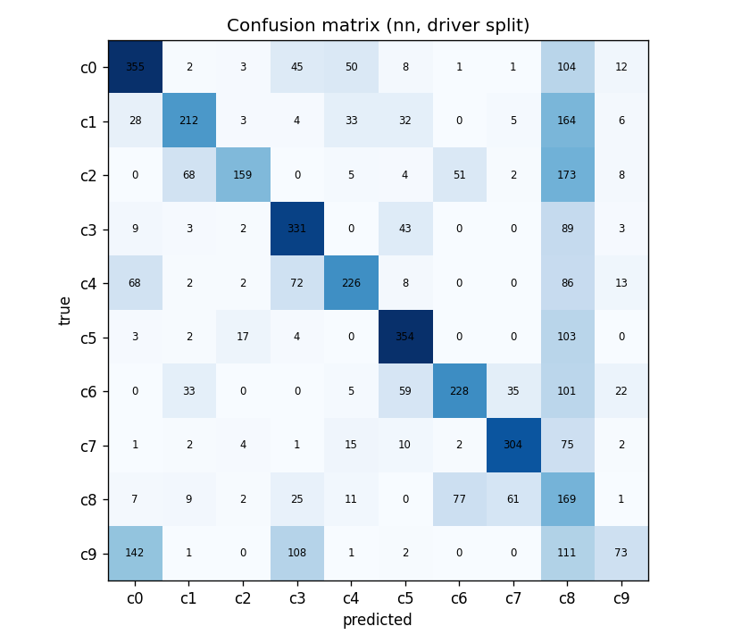
Best model: where the neural net fails
Hair and makeup is a catch-all: 25% of all predictions (1,175 of 4,677) land in c8, though it is only 7.7% of the data. Biggest error: phone-right predicted as c8 (173).
Notes:
Confusion matrix on the driver-wise split for the best model. Strong diagonal for reaching behind, operating the radio and texting-left. The weak spot is the c8 column: the network pushes uncertain right-hand-near-face images into 'hair and makeup'. Phone-right, texting-right, drinking and hair/makeup all share the same pose (right hand near the face) and at 64x64 the object in the hand is only a few pixels. Talk-to-passenger is worst at 16.7% because it has no distinctive object, only head orientation.

Slide 10
Conclusions, limits and demo
What we found
Limitations, next steps
Two-layer NN wins both protocols: 98.0% random, 51.6% driver-wise
Random-split scores are optimistic: -41.6 points on unseen drivers
Gradients verified (error ~1e-10); tuning never touches validation
64x64 pixels lose detail; dense layers ignore spatial structure
One seed, 5 validation drivers
Next: CNN or transfer learning, augmentation, driver-grouped k-fold CV, use of unlabelled test images
Live demo
1 Open the notebook, last section
2 Set IMAGE_PATH (or leave None for a random image)
3 Run: image, predicted activity and top-3 probabilities
Notes:
Close with the three findings, then the honest limitations. Then do the live demo: open distracted_driver_detection.ipynb, scroll to section 8, run the cell. It loads results_driver/model_nn.npz plus the saved mean image, shows the image, prints the prediction and top-3 probabilities. Have one image from a class the model handles well (e.g. reaching behind, operating the radio) ready as backup, and be ready to explain a wrong prediction using the confusion matrix. Repo: github.com/Arya-677/ML_miniProject_sem5.

